Slide 1

Assess Your Daily Health!
Final Project: Health Assessment Webpage
Yujin Han, Biostatistics, GSAS

Slide 2

Health Assessment Webpage
What is it?
A webpage that provides a comprehensive prediction and visualization of the user's health.
By unique ID, the historical health information (stored by healthcare institutions, stable in the short term) and the entered health information (user input, unstable in the short term) are combined to predict the health score
The webpage also provides data visualization and health advice based on final score
Multinomial Model
Institutional Storage
User
Input
Health
Score
Concatenate by Unique ID
$$score=A∗Level+random(B)$$
Notes:
The Health Information Assessment website is a comprehensive prediction of the user's health and provides visual information.
Using a unique ID, the user combines the corresponding locally stored historical health data (which will not change in the short term, e.g. height, presence of high blood pressure) with the entered health data (which will change in the short term, e.g. average daily sleep time, exercise time) to obtain a health assessment score. The website also provides visual information and health advice for the user's assessment results

Slide 3
Health Assessment Webpage
The whole process
01
02
03
04
05
Raw Data
Pre-Processing
Visualization
Training Model
Deployment
BRFSS- 2013
Feature Selection Data Clean
Multinomial Xgboost
Flask

Slide 4
BRFSS- 2013
Description
2013
Measure behavior risk factors for the adult population residing in the US by Land-Line and Cell-Phone
330
491775
FAIR
Metadata
Public-use
Download from CDC website
Data Size
491775 samples, 330 variables related to health information, like diet, exercise, medical history, etc
Behavioral Risk Factor Surveillance System
Health Level
5
Excellent-Very Good-
Good-Fair-Poor

Slide 5
Health Assessment Webpage
The whole process
01
02
03
04
05
Raw Data
Pre-Processing
Visualization
Training Model
Deployment
BRFSS- 2013
Feature Selection Data Clean
Multinomial Xgboost
Flask

Slide 6
Pre-Processing
(491775,330)
03
Historical Health Variables
(23)
Missing Value
Ever Diagnosed with Heart Attack
Ever Told Blood Pressure High
Height, Age,…
01
Delete samples without labels
Only somokeday2 with a missing rate higher than 20%
(Not removed）
(489791,30)
(491775,30)
More Processing
Real-time Variables (5)
How Much Time Do You Sleep
Minutes or Hours exercise
Weight ...
Feature selection
Replace 999, 777 with NA
Replace weekly exercise/sleep time with daily and change units to hours or minutes
Convert a specific type of sport e.g. running, swimming to a number of sport types
Convert weight and height to KG and meters for BMI calculation
Add unique IDs
(489791,30)
Other (2)
02
5 Health Level (Label)
State FIPS Code

Slide 7
Health Assessment Webpage
The whole process
01
02
03
04
05
Raw Data
Pre-Processing
Visualization
Training Model
Deployment
BRFSS- 2013
Feature Selection Data Clean
More details in the webpage
Multinomial Xgboost
Flask

Slide 8
Health Assessment Webpage
The whole process
01
02
03
04
05
Raw Data
Pre-Processing
Visualization
Training Model
Deployment
BRFSS- 2013
Feature Selection Data Clean
Flask
Xgboost
K-means

Slide 9
Training Model
Prediction
Xgboost
Multinomial Xgboost
Missing Value Tolerance
Interpretability
Good classification performance
Train: Test=7:3 & CV=5
K-means
Clustering
K-means
Find groups with similar health conditions to the user and groups with the best health conditions
Give health advice based on comparisons between groups
Cluster=5

Slide 10
Health Assessment Webpage
Final
Webpage
The whole process
Bootstrap4
Chart.js
Atlantis Lite Flask
…
01
02
03
04
05
Raw Data
Pre-Processing
Visualization
Training Model
Deployment
BRFSS- 2013
Feature Selection Data Clean
Multinomial Xgboost
Flask

Slide 11
Health Assessment Webpage

Slide 12
Limitation
Federated Model
Current model still collects user information
Federal learning modelling between health institutions where user history information is stored and user
More privacy
More privacy
More reasonable
Based on correlation and feature importance, no causal relationship can be given
For better health advice, causal inference should be made
Causal inference

Slide 13
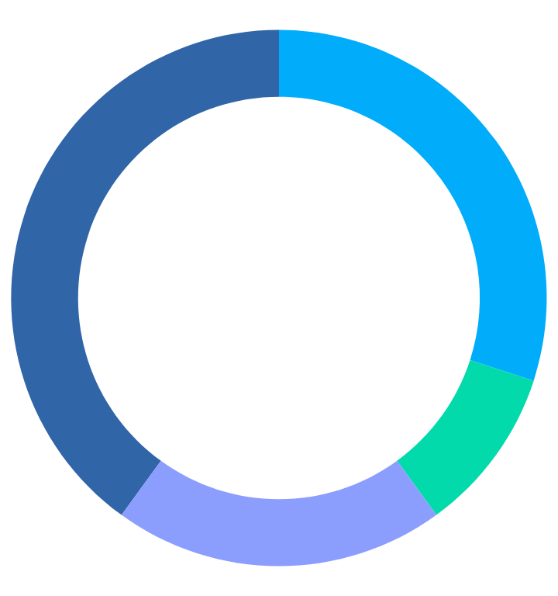
Thanks!

